Slide 1
Parking Sensors: Analyzing and Detecting Parked Domains
Proceedings 2015 Network and Distributed System Security Symposium

Slide 2
Domain Parking
将未开发的域名用于显示除自动生成的广告banner及链接以外，没有任何实质内容的网页，以获取经济收入。

Slide 3










Domain Parking 生态系统
Domain Owner
Parking Page
http://www.domain.com Search
Parking Service
Related links
Link AD
Link
Link _{AD}
Link
Advertisement ^{AD}
Syndicator _{AD}
Advertiser
Domain Owner
(1)
Domain
NS
Parking Page
Parking Service
http://www.domain.com
Search
Related links
AD
Link Link Link Link
(2)
AD
Advertisement Syndicator
AD
AD
(3)
Advertiser

Slide 4
用户到达Parked Domain的方式
Typosquatting 误植域名 – 访问已知网站
猜测域名 - 访问未知网站
从挂马网站或C&C服务器跳转

Slide 5
Parked Domain数据收集
获取Parking service：
研究者调查结果
Alexa.com Google.com
域名相关论坛
得到15个Parking service

Slide 6
Parked Domain数据收集
获取Parked Domain：
注册为Domain Owner，获取Parked Domain配置
DNS Census，2 500 000 000条DNS记录（2012，2013），提取其中符合停放配置的域名
8 064 914 active域名

Slide 7
9
2,000,000
1,500,000
Domains Found
1,000,000
500,000
0
Fabulous
Above
Skenzo
Voodoo
Bodis
Trafficz
SedoParking
CashParking
ParkingCrew
Namedrive
Rookmedia
DomainApps
InternetTraffic
DomainSponsor
TheParkingPlace
Parking Services

Slide 8
Parked Domain分析

Slide 9
Parked Domain Owners
随机选取3000个域名：
1582 Domain – 910 Domain Owner
50% Domain – 15.6%(142) Domain Owner

Slide 10
100%
75%
Parked domains (%)
50%
25%
0%
15.6% 25.0%
50.0%
Domain owners (%)
75.0%
100.0%

Slide 11
Advertisement Syndicator
盈利方式：pay-per-click(PPC)
广告植入方式：（样本量3000）
91%±1% JavaScript代码（Adsense 88%±1.2%，Doubleclick 90%±1.1%，Media.net，Chango）
7%±0.9% 重定向
2%±0.05% 无广告

Slide 12
100
Presence on Parked Websites (%)
75
50
25
0
Doubleclick (Google)
Adsense Media.net (Google)
Advertisement Scripts
Chango

Slide 13
Domain Abuse分析

Slide 14
Typosquatting abuse
Typosquatting model:
Missing-dot
www.facebook.com
www.wwwfacebook.com
Character-omission (discard)
Character-permutation
Adjacent character-substitution
Character-insertion
包含character-duplication
=> reverse-typo transformation
=> 131 673 typosquatting (1.63%)

Slide 15
10
Typosquatting Domains (%)
4
3
2
1
0
Fabulous
Above
Skenzo
Voodoo
Bodis
Trafficz
SedoParking
CashParking
ParkingCrew
Namedrive
Rookmedia
DomainApps
InternetTraffic
DomainSponsor
TheParkingPlace
Parking Services

Slide 16
Trademark abuse
分类：
Typosquatting domains
Cousin domains
实验：
随机选取 500 parked domains
人工提取关键词，并用搜索引擎查询
有相似度很高的域名或组织
79(16%±3.2%) trademark abuse
44(9%±2.5%) typosquatting
35(7%±2.2%) contain trademark

Slide 17
Malicious redirections
分类：
Pay-Per-Redirect(PPR) 7%±0.9% in 3000
Malware
Scams
Adult material
实验方法：
100 domain/ parking service, crawled daily for a week
记录redirection chain，下载最终页面上的所有链接
同时在美国和欧洲进行抓取，以分析地理差异

Slide 18
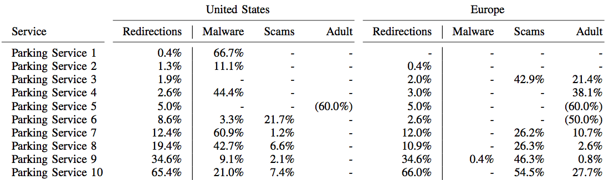




Malicious redirections

Slide 19
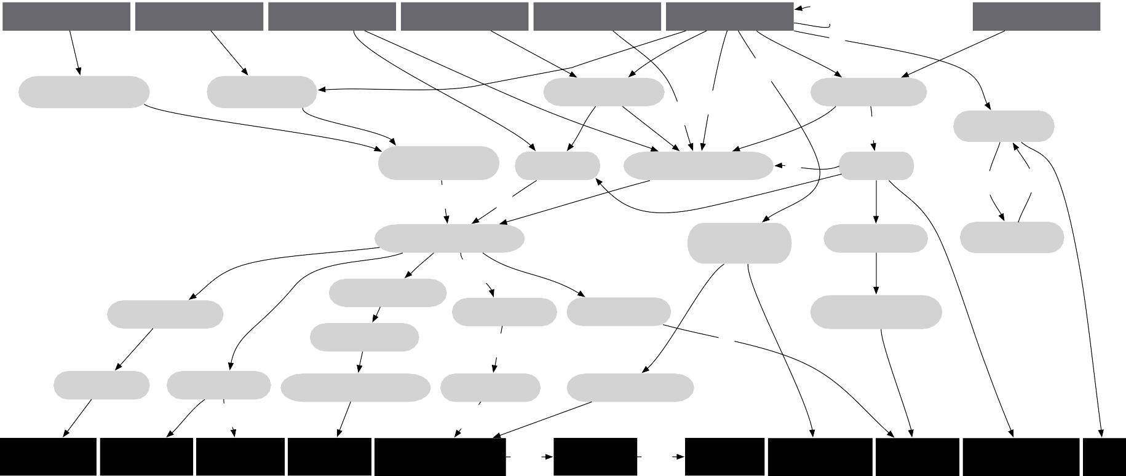
Malicious redirections
Malware(16)：
判断依据：网站存放的可执行文件，被VirusTotal中至少一个搜索引擎报毒
Service 2
Service 1
Service 4
Service 6
Service 7
Service 8
51
Service 10
2
2
5
112
searchterm results.com
seekto explore.com
8
8
otnnetwork.net
51
ndsplitter.com
3
2
65
5
admarket place.net
108
freeresults guide.com
dprtb.com
zeroredirect1.com
2
arclk.net
4
5
5
3
236
zeroredirect2.com
Parent of Service 8
srv123.com
ampx change.com
73
163
5
5
jmp2offer.com
7
recommended update.com
cpvbullet.com
degods.com
downti.com
mpdotrk.com
163
5
byvue.com
mobiclk.com
dllultimatesoft.com
vichnu.com
wttracking.com
10 63
163
7
pchealth boost.com
pcweb health.com
goodsafe pc.com
lpmxp 2014.com
premiumplayer update.com
166
5-pn-ins taller.com
162
oinstaller9. com
pcadvice foryou.com
lpmxp 1001.com
facebookhot search.info
vlc
.cc

Slide 20
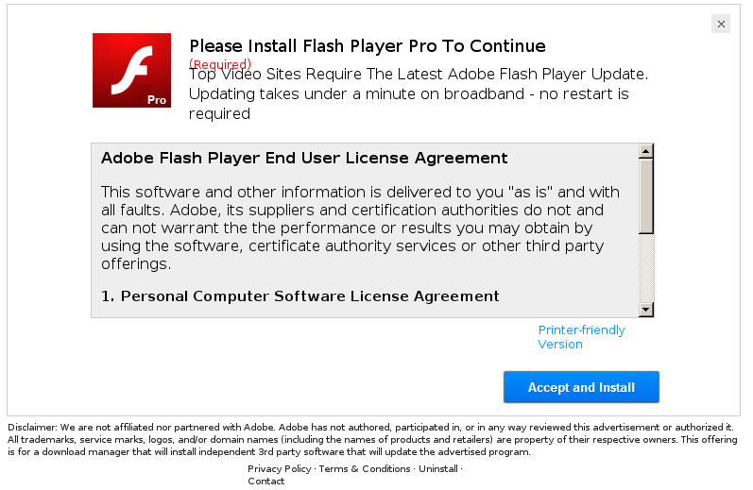
Malicious redirections

Slide 21

Malicious redirections

Slide 22
Malicious redirections
Scam(8+3)：
获取用户敏感信息
声称用户计算机处在高危之中，骗取服务费
Adult material(7+42)：
Adult-oriented(7)
Unrelated or inappropriate(42)

Slide 23
Ad-Blockers检测及绕过
NameDrive：
JavaScript检测”/advertisements.”是否加载
若广告加载正常，则采用PPC
若广告遭到屏蔽，则采用PPR
Fabulous.com：
JavaScript检测google对象是否存在
不存在则创建iframe显示Fabulous.com内部广告链接

Slide 24
Domain Parking 检测

Slide 25
HTML Feature
Average and maximum link length
Average source length
External link and external source ratio
Website directory presence
Link-to-global text ratio
Amount of non-link characters
Text-to-HTML ratio
Redirection mechanisms

Slide 26
HTTP archive Feature
Third-party requests ratio
Third-party data ratio
Third-party HTML content ratio
Initial response size and ration

Slide 27
Frame Feature
Amount of frames
Main frame and iframe redirections
Different final domain

Slide 28
Domain name feature
Typosquatting domain

Slide 29
Classification
目标：给出特定域名是parked的可能性
学习方法：随机森林算法
数据处理：
6000页（2/3用于训练，1/3用于评估）
去除各特征中的离群和极端值网页
忽略效果不好的特征
是否采用匿名服务
域名是否作为第三方请求的参数
评估：
10-fold cross validation

Slide 30
Classification
10-fold cross validation
Threshold 0.5: FPR 1.5% TPR 98.6%
Threshold 0.7: FPR 0.5% TPR 97.9%

Slide 31
100.0%
98.6%
97.9%
True Positive Rate
95.0%
90.0%
0.1%
0.5%
1.0%1.5% 10.0%
False Postive Rate (log scale)
100.0%

